Slide 1
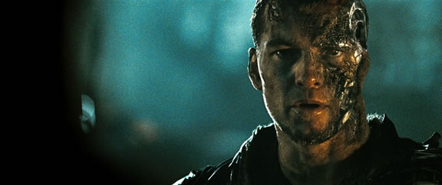
Ethics
What is truly right? For humans? For robots?
Asimov’s Three Sets of Robotic Laws (Runaround)
Replacing humans with robots
Capable of so much, but to what extent?
“We have hundreds of examples today of Narrow AI… and the narrowness is gradually getting less narrow”
Kurzweil’s “Merging with the Machines”
Sam Worthington as Marcus Wright,
Terminator Salvation
Notes:
Refer to Asimov’s Three Sets of Robotic Laws, Runaround = Short story introduced by Asimov about a space trip to Mercury involving the use of
A robot may not injure a human being, or, through inaction, allow a human being to come to harm.
A robot must obey orders given it by human beings except where such orders would conflict with the First Law.
A robot must protect its own existence as long as such protection does not conflict with the First or Second Law. (I, Robot,6)

